Slide 1


Professionalism
Bhagyashri Khimsuria 53
Hema Paun 48
Ruchita Sagathiya 36
Prerana Shukla 31
SEM3
ICT

Slide 2

WHAT IS PROFESSIONALSIM??

Slide 3
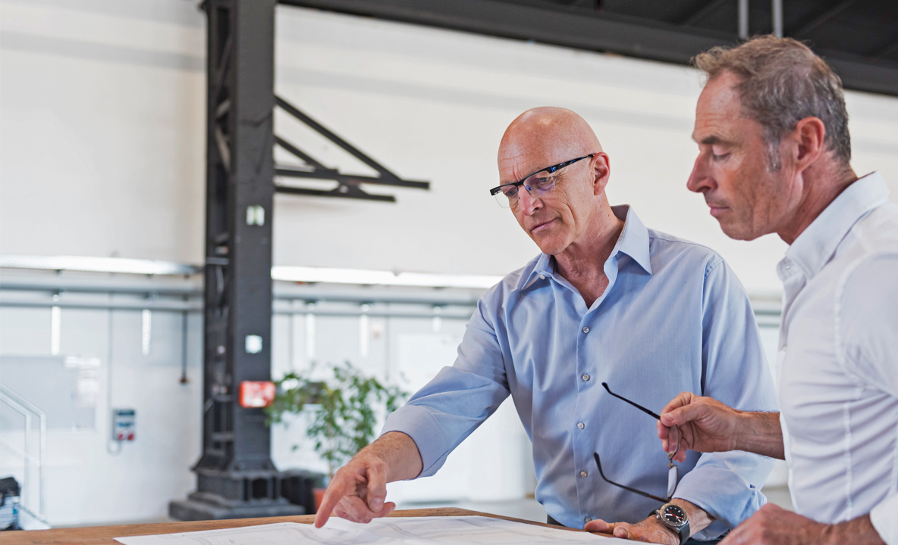
Professionalism
The Merriam – Webster dictionary defines professionalism as “The conduct, aims, or qualities that characterize or mark a profession or a professional person”, and it defines a profession as “ a calling requiring specialized knowledge and often long and intensive academic preparation.”
Professionalism encompasses a number of different attributes identify and define a professional.

Slide 4


KEYWORDS
To improve your own professionalism focus on improving in each of these areas.
Specialized Knowledge
Honesty and Integrity
Competency
Respect
Accountability
Self Regulation
Image

Slide 5

KEYWORDS
Specialized Knowledge
Competency
Honesty and Integrity
Professionals make a deep personal commitment to develop and improve their skills.
Doctor, Pilot, Lawyer
Plumber, Automotive Mechanic,
Electrician
Professionals get the job done.
Professionals are reliable.
Professionals keep their promises.
Professionals don’t make excuses, but focus on finding solutions
Professionals don’t lie, cheat, or steal.
Professionals can be trusted.
Professionals don’t compromise their values.
Professionals will do the right thing even if it means taking a harder road.

Slide 6
KEYWORDS
Accountability
Self Regulation
Image
Professionals hold themselves accountable for their thoughts, words, and actions – especially when they’ve made a mistake.
• Accountability is closely tied to honesty and integrity and is a vital element in professionalism.
Professionalism under pressure.
Professionals show respect for the people around them, no matter what their role or situation.
• They exhibit a high degree of emotional intelligence by considering the emotions and needs of others.
Professionals look the part.
• They don’t show up at work sloppily dressed, with unkempt hair.
• They’re polished, and they dress appropriately for the situation.
• Because of this, they exude an air of confidence and they gain respect for this.

Slide 7


Examples based on the characteristic of professionalism
Being on time
Looking the part
Loyalty to the team
Supporting co workers
Telling the truth
Working at work time
You can also exude professionalism by being kind and polite to everyone , presenting a professional image in your attitude and dree, and showing up for school (and work) fully prepared.
Although professionalism means keeping commitments, doing high quality work, and having expert status, occasionally the pursuit of these attributes might tempt you not to volunteer for projects that fall outside your comfort zone

Slide 8

THANK YOU!

